Slide 1
UNIT - 04
UX
Design
Process

Slide 2
1.UX
Goals

Slide 3
“UX goals are high-level objectives for an interaction design, stated in terms of
anticipated user experience”
▪ UX goals can be driven by business goals and reflect real use of a product and
identify what is important to an organization, its customers, and its users.
▪ They are expressed as desired effects to be experienced in usage by users of
features in the design and they translate into a set of UX measures.
▪ A UX measure is a usage attribute to be assessed in evaluating a UX goal.

Slide 4
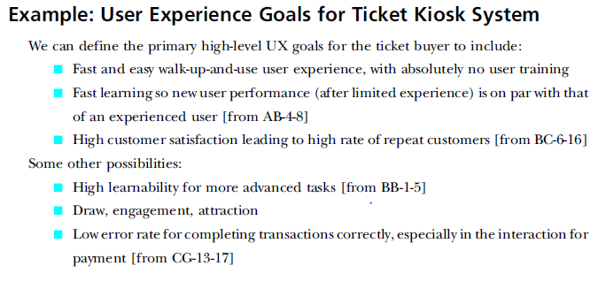

Slide 5
Measuring Instrument
“A measuring instrument is the means for providing values for a particular UX measure; it is the vehicle through which values are generated and measured. A typical measuring instrument for generating objective UX data is a benchmark task—for example, user performance of a task gives time and error data—while a
typical measuring instrument for generating subjective UX
questionnaire”
data is a

Slide 6
UX
Target
Tables

Slide 7
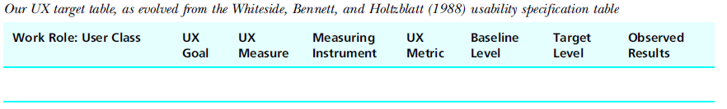
▪ Through years of working with real-world UX practitioners and doing our own
user experience evaluations, we have refined the concept of a
UX target table.
▪ For convenience, one row in the table is called a “UX target.”
▪ The first three columns are for the work role and related user class to which this
UX target applies, the associated UX goal, and the UX measure.
▪ The three go together because each UX measure is aimed at supporting a UX goal
and is specified with respect to a work role and user class combination.

Slide 8
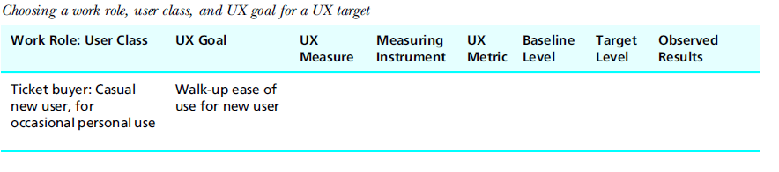
Work
Roles,
User
Classes,
And
UX
Goals

Slide 9
UX Measures
Some common UX measures that can be paired with quantitative metrics include:
Objective UX measures (directly measurable by evaluators)
▪ Initial performance
▪ Long-term performance (longitudinal, experienced, steady state)
▪ Learnability
▪ Retainability
Subjective UX measures (based on user opinions)
▪ First impression (initial opinion, initial satisfaction)
▪ Long-term (longitudinal) user satisfaction

Slide 10
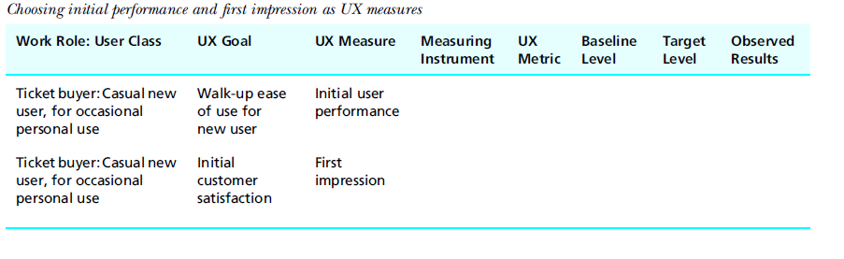

Slide 11
Benchmark Task
“A benchmark task is a description of a task
performed by a participant in formative evaluation so that UX measures such as time-on-task and error rates can be obtained and compared to a baseline value across the performances of multiple participants”

Slide 12
Measuring Instruments
Benchmark Tasks
• Address designer questions with benchmark tasks and UX targets
• Selecting benchmark tasks
– Create benchmark tasks for a representative spectrum of user tasks.
– Start with short and easy tasks and then increase difficulty progressively.
– Include some navigation where appropriate.
– Avoid large amounts of typing (unless typing skill is being evaluated).
– Match the benchmark task to the UX measure.
– Adapt scenarios already developed for design.
– Use tasks in realistic combinations to evaluate task flow.

Slide 13
– Do not forget to evaluate with your power users.
– To evaluate error recovery, a benchmark task can begin in an error state.
– Consider tasks to evaluate performance in “degraded modes” due to partial
equipment failure.
– Do not try to make a benchmark task for everything.
• Constructing benchmark task content
Remove any ambiguities with clear, precise, specific, and repeatable instructions.
– Tell the user what task to do, but not how to do it.
Do not use words in benchmark tasks that appear specifically in the interaction design.

Slide 14
– Use work context and usage-centered wording, not system-oriented wording.
– Have clear start and end points for timing.
– Keep some mystery in it for the user.
– Annotate situations where evaluators must ensure pre-conditions for running
benchmark tasks.
– Use “rubrics” for special instructions to evaluators.
– Put each benchmark task on a separate sheet of paper.
– Write a “task script” for each benchmark task.

Slide 15
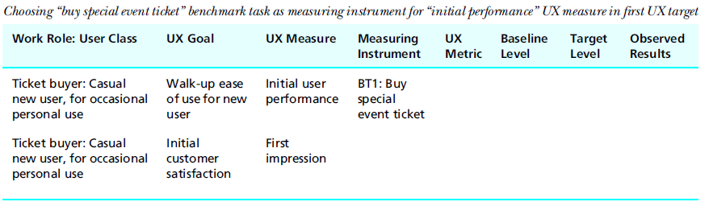

Slide 16
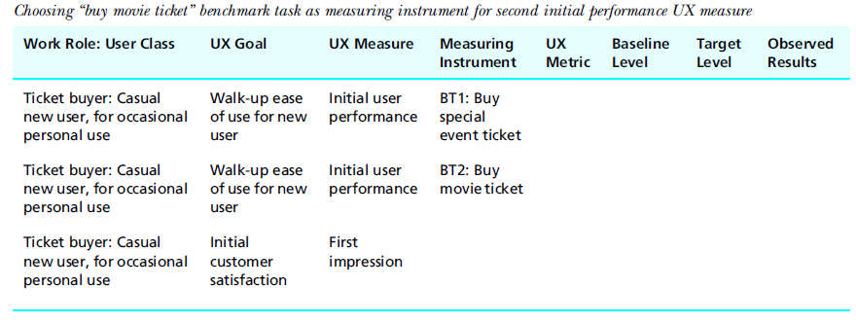

Slide 17
• How many benchmark tasks and UX targets do you need?
Ensure ecological validity [Write your benchmark task descriptions, how can the setting be made more realistic?]
– What are constraints in user or work context?
– Does the task involve more than one person or role?
– Does the task require a telephone or other physical props?
– Does the task involve background noise?
– Does the task involve interference or interruption?
– Does the user have to deal with multiple simultaneous inputs, for example
,multiple audio feeds through headsets?

Slide 18
User Satisfaction Questionnaires
As a measuring instrument for a subjective UX measure, a questionnaire related to various user interaction design features can be used to determine a user’s satisfaction with the interaction design.

Slide 19
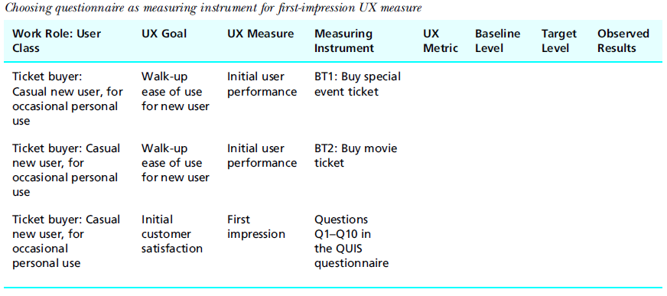

Slide 20
UX METRICS
A UX metric describes the kind of value to be obtained for a UX measure. It states what is being measured. There can be more than one metric for a given measure.
Most commonly, UX metrics are objective, performance-oriented, and taken while the participant is doing a benchmark task. Other UX metrics can be subjective, based on a rating or score computed from questionnaire results.
Typical objective UX metrics include time to complete task1 and number of errors made by the user. Others include frequency of help or documentation use; time spent in errors and recovery; number of repetitions of failed commands and the number of commands, mouse-clicks, or other user actions to perform task(s)

Slide 21
Typically, subjective UX metrics will represent the kind of numeric outcome you want from a questionnaire, usually based on simple arithmetic statistical measures such as the numeric average.

Slide 22
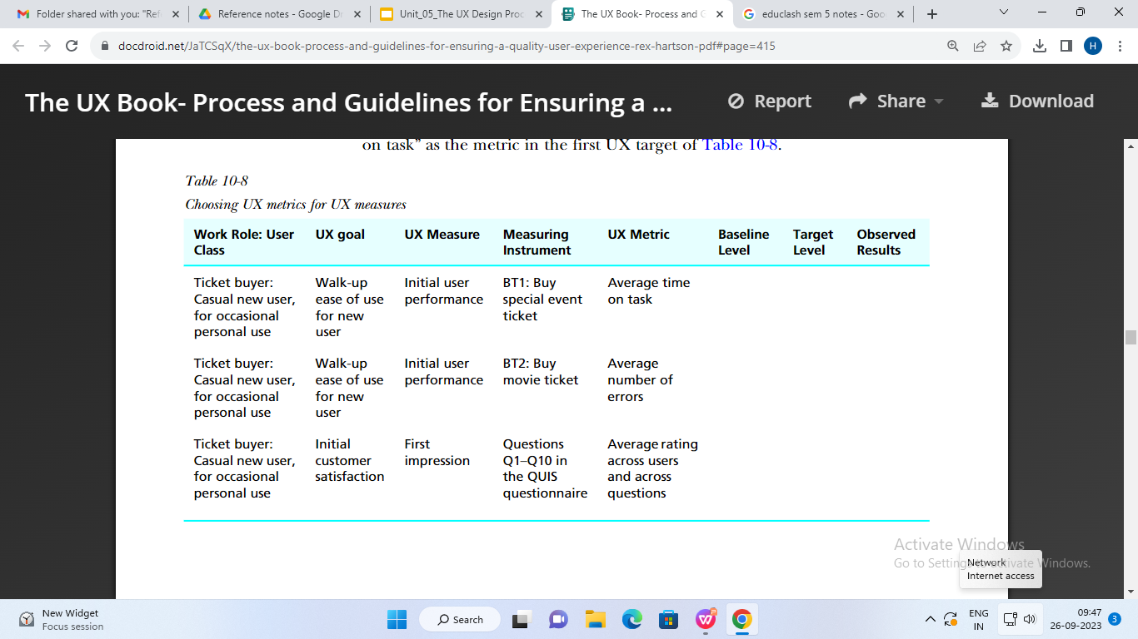

Slide 23
BASELINE LEVEL
The baseline level is the benchmark level of the UX metric; it is the “talking point” level against which other levels are compared. It is often the level that has been measured for the current version of the system (automated or manual).

Slide 24
UX
Evaluation
Techniques

Slide 25
Formative Vs. Summative Evaluation
• When the cook tastes the soup, that’s formative; when the guests taste the
soup, that’s summative” (Stake, 2004, p. 17).
– Formative evaluation is primarily diagnostic; it is about collecting
qualitative data to identify and fix UX problems and their causes in the
design.
– Summative evaluation is about collecting quantitative data for
assessing a level of quality due to a design, especially for assessing
improvement in the user experience due to formative evaluation.

Slide 26
• Qualitative Data
– Qualitative data are non-numeric and descriptive data, usually describing a
UX problem or issue observed or experienced during usage.
• Quantitative Data
Quantitative data are numeric data, such as user performance metrics or opinion ratings.

Slide 27
• Formal summative evaluation
Formal summative evaluation is a kind of controlled hypothesis testing with
a m by n factorial design with y independent variables, the results of
which are subjected to statistical tests for significance. Formal summative
evaluation is an important HCI skill.
• Informal summative evaluation
is used, as a partner of formative evaluation, for quantitatively summing up
or assessing UX levels using metrics for user performance (such as the
time on task), for example, as indicators of progress in UX improvement,
usually in comparison with pre-established UX target levels.

Slide 28
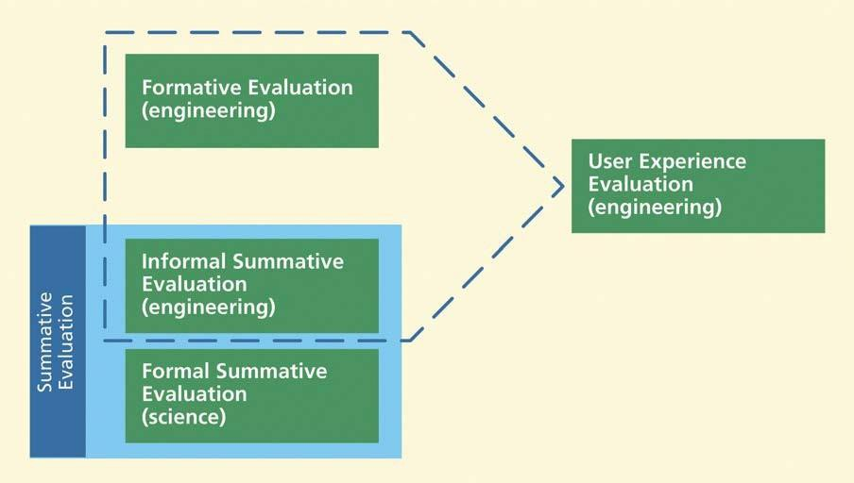
• Engineering Evaluation of UX: Formative Plus Informal Summative
UX evaluation is a combination of formative and informal summative evaluation.

Slide 29
Types Of Formative And Informal Summative Evaluation
Methods
• Dimensions for Classifying Formative UX Evaluation Methods
– empirical method vs. analytic method
– rigorous method vs. rapid method
• Rigorous Method vs. Rapid Method
Choose a rigorous empirical method such as lab-based testing when you need
effectiveness and thoroughness, but expect it to be more expensive and time-
consuming.
Choose the lab-based method to assess quantitative UX measures and metrics,
such as time-on-task and error rates, as indications of how well the user does
in a performance- oriented context.

Slide 30
–
Choose lab-based testing if you need a controlled environment to limit
distractions.
Choose empirical testing in the field if you need more realistic
usage conditions for ecological validity than you can establish in a
lab.
However, UX evaluation methods can be faster and less expensive.
Choose a rapid evaluation method for speed and cost savings, but
expect it to be ( or possibly acceptably) less effective.
Choose a rapid UX evaluation method for early stages of progress, when things are changing a lot, anyway, and investing in detailed evaluation is not warranted.
Choose a rapid method, such as a design walkthrough, an informal demonstration of design concepts, as a platform for getting initial reactions and early feedback from the rest of the design team, customers, and potential users.
–
–
–
–
–

Slide 31
• Analytic Method vs. Empirical Method
– Analytical methods are based on looking at inherent attributes of the design
– rather than seeing the design in use.
– Empirical methods employ data observed in the performance of real user participants, usually data collected in lab-based testing.

Slide 32
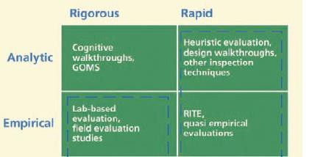
• Where the Dimensions Intersect
Sample UX evaluation methods at intersections between the dimensions of UX
evaluation method types.

Slide 33
6.3 Types Of Evaluation
Data
• Objective Data vs. Subjective Data
– Objective UX data are data observed directly by either the evaluator or the
participant.
– Subjective UX data represent opinions, judgments, and other subjective
feedback usually from the user, concerning the user experience
satisfaction with the interaction design.
and

Slide 34
• Quantitative Data vs. Qualitative Data
Quantitative data are numeric data, such as data obtained by user
performance metrics or opinion ratings. Quantitative data are the basis of
a informal summative evaluation component and help the team assess
U achievements and monitor convergence toward UX targets, usually
in comparison with the specified levels set in the UX targets.
Qualitative data are non-numeric and descriptive data, usually describing
a UX problem or issue observed or experienced during usage. Qualitative
data are usually collected via critical incident and/or the think aloud
technique and are the key to identifying UX problems and their causes

Slide 35
6.4
•
Some Data Collection Techniques
Critical Incident Identification
–
–
–
the user’s general activity or task
objects or artifacts involved
the specific user intention and action that led immediately to the critical
incident
expectations of the user about what the system was supposed to do when
the critical incident occurred
what happened instead
as much as possible about the mental and emotional state of the user
indication of whether the user could recover from the critical incident
and, if so, a description of how the user did so
additional comments or suggested solutions to the problem
–
–
–
–
–

Slide 36
– Relevance of critical incident data
– History of critical incident data
– Mostly used as a variation
– Critical incident reporting tools
– Who identifies critical incidents?
– Timing of critical incident data capture: The evaluator’s
awareness zone

Slide 37
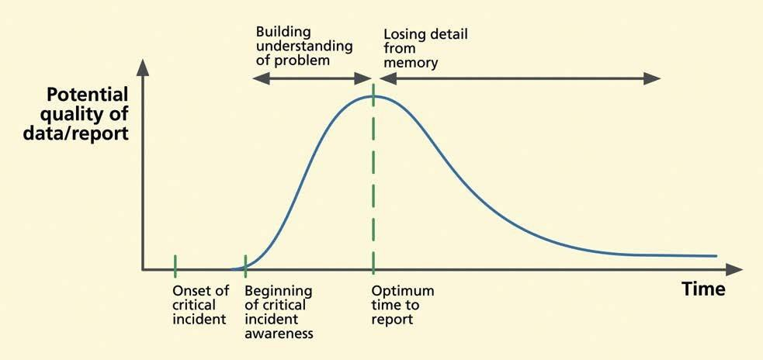
Critical incident
descri^{C}p^{om}ti^{p}o^{ile}n^{d B}d^{y..}e^{.P}t^{ro}a^{f.}i^{S}l^{ha}v^{z}s^{iy}.^{a S}t^{h}iªm^{ikh}e^{,TIM}a^{S}f^{C}t^{D}e^{R}r
critical incident.

Slide 38
• The Think-Aloud Technique
• Questionnaires
– Semantic differential scales
– The Questionnaire for User Interface Satisfaction (QUIS)
– The System Usability Scale (SUS)
– The Usefulness, Satisfaction, and Ease of Use (USE) Questionnaire

Slide 39
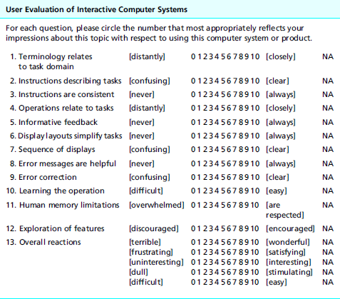
An excerpt from QUIS, with permission

Slide 40
• The System Usability Scale (SUS)
The questions are presented as simple declarative statements, each with a five point Like scale anchored with “strongly disagree” and “strongly agree” and with values of 1 through 5. These 10 statements are:
–
–
–
–
I think that I would like to use this system frequently
I found the system unnecessarily complex
I thought the system was easy to use
I think that I would need the support of a technical person to be able to use this system
I found the various functions in this system were well integrated
I thought there was too much inconsistency in this system
I would imagine that most people would learn to use this system very quickly
I found the system very cumbersome to use
I felt very confident using the system
I needed to learn a lot of things before I could get going with this system
–
–
–
–
–
–

Slide 41
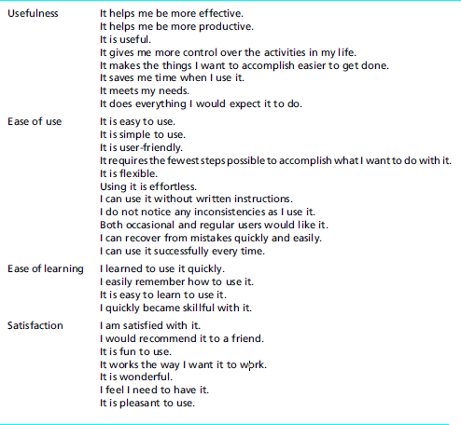
Questions in USE questionnaire

Slide 42
• General-purpose usability questionnaires:
–
Computer System Usability Questionnaire (CSUQ), developed by Jim
Lewis (1995, 2002) at IBM, is well-regarded and available in the public domain.
Software Usability Measurement Inventory (SUMI) is “a rigorously tested and proven method of measuring software quality from the end user’s point of view” (Human Factor Research Group, 1990). According to Usability Net, SUMI is “a mature questionnaire whose standardization base and manual have been regularly updated.” It is applicable to a range of application types from desk-top applications to large domain-complex applications.
After Scenario Questionnaire (ASQ), developed by IBM, is available in
the public domain (Bangor, Kortum, & Miller, 2008, p. 575).
Post-Study System Usability Questionnaire (PSSUQ), developed by IBM, is available in the public domain (Bangor, Kortum, & Miller, 2008, p.
575).
–
–
–

Slide 43
• Web evaluation questionnaires:
– Website Analysis and Measurement Inventory (WAMMI) is “a short but very reliable questionnaire that tells you what your visitors think about your web site” (Human Factor Research Group, 1996b).
• Multimedia system evaluation questionnaires:
– Measuring the Usability of Multi-Media Systems (MUMMS) is a
questionnaire “designed for evaluating quality of use of multimedia software products” (Human Factor Research Group, 1996a).
• Hedonic quality evaluation questionnaires:
– The Lavie and Tractinsky (2004) questionnaire
– The Kim and Moon (1998) questionnaire with differential emotions scale

Slide 44
• Modifying questionnaires for your evaluation
– choosing a subset of the questions
– changing the wording in some of the questions
– adding questions of your own to address specific areas of concern
– using different scale values

Slide 45
• Data Collection Techniques Especially for Evaluating Emotional
Impact
– Self-reported indicators of emotional impact
Questionnaires as a verbal self-reporting technique for collecting emotional impact data
– Observing physiological responses as indicators of emotional
impact
– Bio-metrics to detect physiological responses to emotional impact

Slide 46
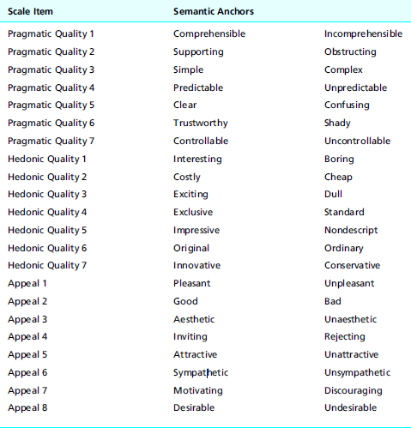
AttrakDiff emotional impact questionnaire as listed by Hassenzahl,
Scho¨bel, and Trautman (2008), with permission

Slide 47
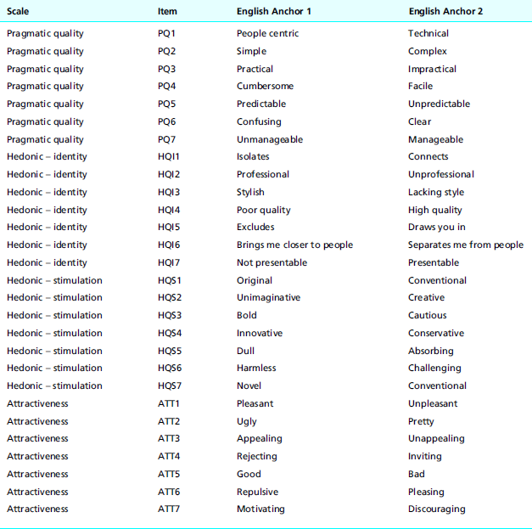
A variation of the AttrakDiff emotional impact questionnaire, as listed , Held and
Laugwitz (2006), reordered to group related items together, with permission

Slide 48
• Data Collection Techniques to Evaluate Phenomenological Aspects of
Interaction
– Long-term studies required for phenomenological evaluation
– Goals of phenomenological data collection techniques
– Diaries in situated longitudinal studies
– Evaluator triggered reporting for more representative data
– Periodic questionnaires over time
– Direct observation and interviews in simulated real usage situations

Slide 49
6.5 Variations In Formative Evaluation Results
• Reasons given by Hertzum and Jacobsen (2003) for the wide
variation
– vague goals (varying evaluation focus)
– vague evaluation procedures (the methods do not pin down the
procedures so each application is a variation and an adaptation)
– vague problem criteria (it is not clear how to decide when an
issue
represents a
real problem)

Slide 50
7.
Informal Summative (Quantitative)
Data
Analysis

Slide 51
“ It’s a Rigorous UX evaluation – Data Analysis “
7.1 Lining up Your Quantitative Ducks
▪ The first step in analyzing quantitative data is to compute simple descriptive
statistics (e.g., averages) for timing, error counts, questionnaire ratings, and so on,
as stated in the UX targets.
▪ After you compute summary statistics of quantitative data, you add them to the
“Observed Results” column at the end of the UX target table. As an example,
partial results from a
shown,
hypothetical evaluation of the Ticket Kiosk System are

Slide 52
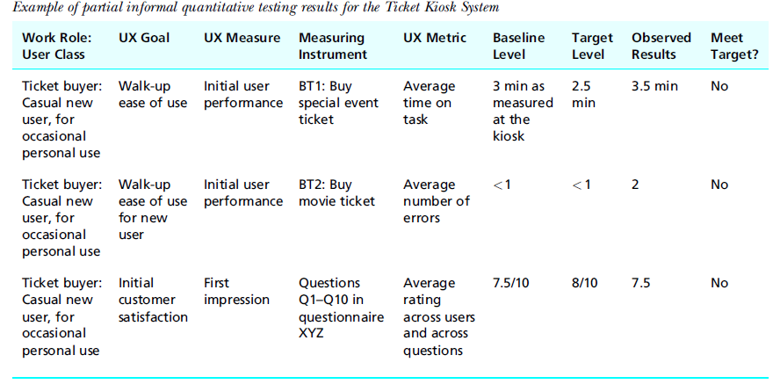

Slide 53
7.2 The Big Decision: Can We Stop Iterating?
▪ Now it is time for a major project management decision: Should you continue to
iterate? This decision should be a team affair and made at a global level, not just considering quantitative data. Here are some questions to consider:
– Did you simultaneously meet all your target-level goals?
– What is your general team feeling about the conceptual design, the overall
interaction design, the metaphor, and
observed?
the user experiences they have

Slide 54
▪ If you can answer these questions positively, you can accept the design as is and
stop iterating.
▪ Resource limitations also can force you to stop iterating and get on with pushing
this version out in the hope of fixing known flaws in the next version.
▪ If and when you do decide to stop iterating, do not throw your qualitative data
away,
though; you paid to get it,
so keep this round of
problem data for next time.

Slide 55
8.
Formative (Qualitative)
Analysis
Data

Slide 56
▪
▪
Formative analysis of qualitative data is the bread and butter of UX evaluation.
The goal of formative data analysis is to identify UX problems and causes (design
flaws) so that they can be fixed, thereby improving product user experience.
The process of determining how to convert collected data into scheduled design
and implementation solutions is essentially one of negotiation in which, at various
times, all members of the project team are involved.
In the first part of qualitative analysis you should have all your qualitative data
represented as a set of UX problem instances so that you can proceed with
diagnosis and problem solutions.
Figure illustrates the steps of qualitative data analysis: consolidating large sets of raw critical incident comments into UX problem instances, merging UX problem instances into UX problem records, and grouping of UX problem records so that we can fix related problems together.
▪
▪
▪

Slide 57
▪ For practical purposes we have to separate our material into chapters.
▪ In practice, early analysis—especially for qualitative data—overlaps with the data
collection process. Because evaluator comments are interpretive, we have already
begun to overlap analysis of qualitative data with their capture.
▪ The earlier you think about UX problems and their causes, the better chance you
have at getting all the information you
will need for problem diagnosis.

Slide 58
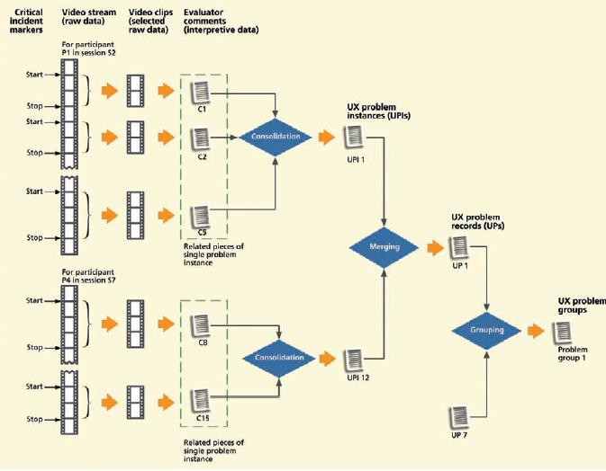

Slide 59
8.1 Get an Early Jump on Problem Analysis
▪ Keep a participant around to help with early analysis
▪ Early UX problem data records
▪ Clean up your raw data before your memory fades
▪ Clarify and amplify your emotional impact data
8.2
8.3
8.4
Sources of Raw Qualitative Data
Isolate Individual Critical Incident Descriptions
Consolidating Raw Critical Incident Notes into UX
Instances
Problem
▪ The UX problem instance concept
▪ Gathering up parts of data for a critical incident
Example: Consolidating Critical Incident Parts
of a Single UX Problem Instance
▪ Putting it into a UX problem instance

Slide 60
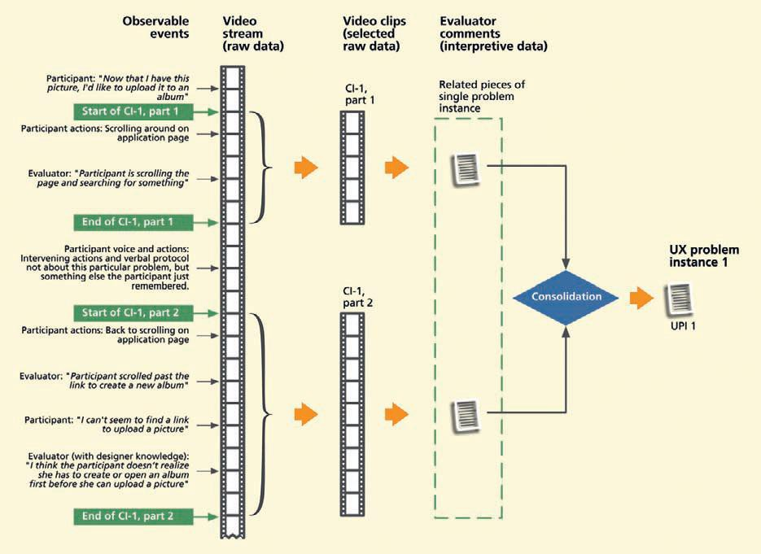

Slide 61
Problem Instance (UX)
“A UX problem instance is a single occurrence of an encounter with a given problem by a given user, inspector, or participant. When more than one participant experiences what is essentially the same problem, the encounters are counted as different
instances so they are not reported as different problems.”
Critical Incident
“A critical incident is a UX evaluation event that occurs during user task performance or other user interaction, observed by the facilitator or other observers or sometimes expressed by the user participant, that indicates a possible UX problem. Critical incident identification is arguably the single most important source of qualitative
data.”

Slide 62
8.5 UX Problem Instances
▪ UX problem instance content
–
–
–
▪ UX
–
–
Understand each problem
Glean insight into its causes and possible solutions
Be conscious of relationships among similar problems
problem instance project context
Organization (e.g., company, department)
Project (e.g., product or system, project management, dates, budget,
personnel)
Version (e.g., design/product release, version number, iteration number)
Evaluation session (e.g., date, participants, evaluators, associated UX
target table)
Task run (e.g., which task, associated UX targets)
–
–
–

Slide 63
8.6 Merge Congruent UX Problem Instances into UX Problem
Records
▪ Find and merge multiple UX problem instances representing the same problem
▪ Create UX problem records
▪ Group Records of Related UX Problems for Fixing Together
–
Problems may be in physical or logical proximity (e.g., may involve objects
or actions within the same dialogue box).
Problems may involve objects or actions used in the same task.
Problems may be in the same category of issues or design features but scattered throughout the user interaction design.
Problems may have consistency issues that require similar treatments.
Observed problem instances are indirect symptoms of common, more deeply
rooted,
UX problems. A telling indicator of such a deeply rooted problem is complexity and difficulty in its analysis.
–
–
–
–
–

Slide 64
8.7 UX Problem Data Management
Each UX problem record will eventually contain information about the problem:
diagnosis by problem type and subtype, interaction design flaws as problem causes,
cost/importance data estimating severity, management decisions to fix (or not) the
problem, costs, implementation efforts, and downstream effectiveness.
8.8 Abridged Qualitative Data Analysis
▪ As an abridged approach formative (qualitative) data analysis:
– Just take notes about UX problems in real time during the session.
– Immediately after session, make UX problem records from the notes.
▪ As an alternative, if you have the necessary simple tools for creating UX
problem records:
Create UX problem records as you encounter each UX problem during the session.
– Immediately after the session, expand and fill in missing information in the
records.
Analyze each problem, focusing on the real essence of the problem and noting causes (design flaws) and possible solutions.

Slide 65
9.
Feedback
to
Process

Slide 66
▪
Now that you have been through an iteration of the UX process lifecycle, it is
time to reflect not just on the design itself, but also on how well your process worked.
If you have any suspicions after doing the testing that the quantitative criteria
were not quite right, you might ask if your UX targets worked well.
For example, if all target levels were met or exceeded on the very first round of evaluation, it will almost certainly be the case that your UX targets were too lenient.
Even in later iterations, if all UX targets are met but observations during evaluation sessions indicate that participants were frustrated and performed tasks poorly, your intuition will probably tell you that the design is nevertheless not acceptable in terms of its quality of user experience.
▪
▪
▪

Slide 67
▪
Then, obviously, the UX team should revisit and adjust the UX targets or
add more considerations to your criteria for evaluation success.
Next, ask yourself whether the benchmark tasks supported the evaluation process in the most effective way.
Should they have been simpler or more complex, narrower or broader? Should any benchmark task description be reworded for clarification or to give less information about how to do a task?
Finally, assess how well the overall process worked for the team. You will never be in a better position to sit down, discuss it, and document possible improvements for the next time.
▪
▪
▪

Slide 68
10.
Evaluation
Report

Slide 69
10.1 Introduction
10.1.1 Importance of Quality Communication and Reporting
▪ All the effort and cost you invested thus far in UX evaluation can be wasted at the last minute if you do not follow up now to:
– Inform the team and project management about the UX problems in the
current design
– Persuade them of the need to invest even more in fixing those problems.
10.1.2 Participant Anonymity
▪ Participant anonymity does not mean that you, as the evaluator or facilitator, do
not know the names of participants. Somewhere along the line someone must have recruited and signed up and possibly even paid the participants.
▪ You should keep participant identification information in just one place—on a sheet of paper or in a database mapping the names to identification codes.
▪ Codes, never names, are used everywhere else in the evaluation process—on data
collection forms, during data analysis, and in all reports.

Slide 70
10.2 Reporting Informal Summative Results
▪ the audience for your informal summative evaluation results should be strictly
limited to your own project group.
▪ They are to be used only as an engineering tool within the project.
▪ You must be answerable to these questions:
– What if You Are Required to Produce a Formative Evaluation Report for
Consumption Beyond the Team?
– What if You Need a Report to Convince the Team to Fix the Problems?
10.3 Reporting Qualitative Formative Results
▪ Common Industry Format (CIF) for Reporting Formal Summative UX
Evaluation Results . The CIF standard calls out requirements
include:
– A description of the product
– Goals of the testing
– A description of the number and types of participants
– Tasks used in evaluation
for
reports
to

Slide 71
– The experimental design of the test (very important for formal summative
studies because of the need for eliminating any biases and to ensure the results do not suffer from external, internal, and other validity concerns)
– Evaluation methods used
– Usability measures and data collection methods employed
– Numerical results, including graphical methods of presentation
▪ The American National Standards Institute (ANSI) approved this
for summative reporting as ANSI-NCITS 354-2001 in December it became an international standard, ISO/IEC 25062: Software
standard
2001
and
Engineering—Software Product Quality Requirements and Evaluation
(SQuaRE), in May 2005.
▪ Common Industry Format (CIF) for Reporting Qualitative Formative
Results.

Slide 72
10.4 Formative Reporting Content
▪ Individual Problem Reporting Content
The basic information needed includes:
– the problem description
– a best judgment of the causes of the problem in the design
– an estimate of its severity or impact
– suggested solutions
▪ Include Video Clips Where Appropriate
▪ Pay Special Attention to Reporting on Emotional Impact Problems
▪ Including Cost-Importance Data
10.5 Formative Reporting Tone
▪ Respect feelings: Bridle your acrimony
▪ Accentuate the positive and avoid blaming
10.6 Formative Reporting over Time

Slide 73
10.7 Problem Report Effectiveness: The Need to Convince
and Get Action with Formative Results
▪ Problem severity: more severe problems are more salient and carry more weight with designers
▪ Problem frequency: more frequently occurring problems are more likely to
be perceived as “real”
▪ Perceived relevance of problems: designers disagreeing with usability
practitioners on the relevance (similar to “realness”) of
problems
did
not
fix
problems
that
practitioners
recommended
be fixed

